Slide 1

DR5.2 CURL
Andrew Beatty
Andrew.Beatty@gmit.ie
Data Represtentation

Slide 2

What is CURL
Client-side URL
Used to call a URL and retrieve its response
Handy for testing and debugging
(I have used it to webscrape, “back in the day”)
curl http://www.google.com

Slide 3
Installation
Come built in to Windows 10 and mac
Other wise download the zip from https://curl.haxx.se/download.html
Unzip it and save the curl.exe and any .dll file to a directory in your PATH variable

Slide 4
Some options
-i see the response header
curl -i http://dummy.restapiexample.com/api/v1/employee/2201
-X <method> set the method
curl -i -X DELETE http://dummy.restapiexample.com/api/v1/delete/2201
-d <data> set the data to be uploaded
-H <header> set the header
curl -i -H "Content-Type:application/json" -X PUT -d '{"name":"test1","salary":"1123","age":"23"}' http://dummy.restapiexample.com/api/v1/update/2201

Slide 5
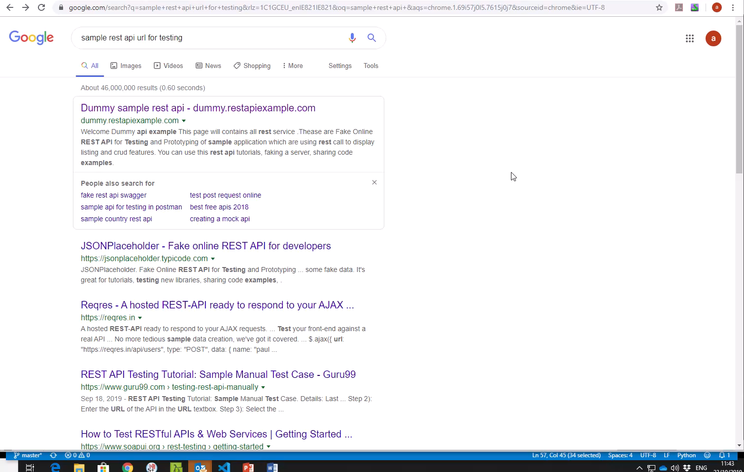

Slide 6
Conclusion
CURL is handy for testing
We will use in in the next lecture to test the server we are running

